Slide 1
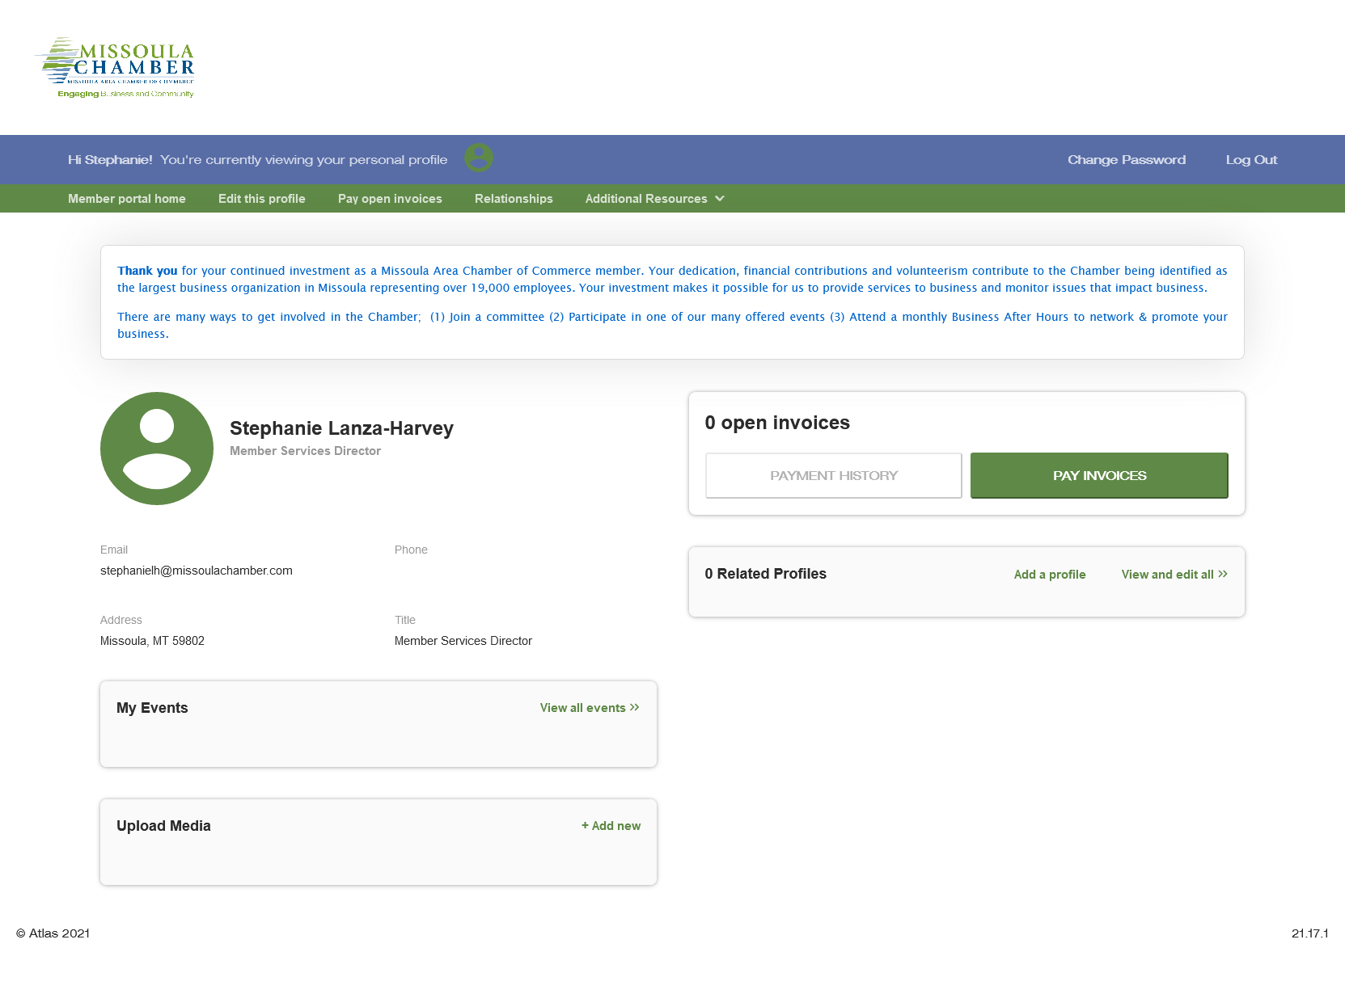
A Member’s Guide to the
Members-Only Area
Missoula Area Chamber of Commerce
An illustrated guide to getting the most out of our interactive self-service profile page
Brought to you by

Slide 2
Membership has its privileges
Our website is powered by MemberClicks by Personify, the association industry’s most powerful Association Management Software system.
Our website offers many self-service and exclusive benefits that only members and/or their employees can take advantage of.
To ensure only members receive these benefits, these areas of our site require a valid log in.
The pages in this guide will teach you how to log in and update your information, as well as take advantage of as many benefits as possible.
The more you update and personalize your membership, the more value you will receive from us!

Slide 3
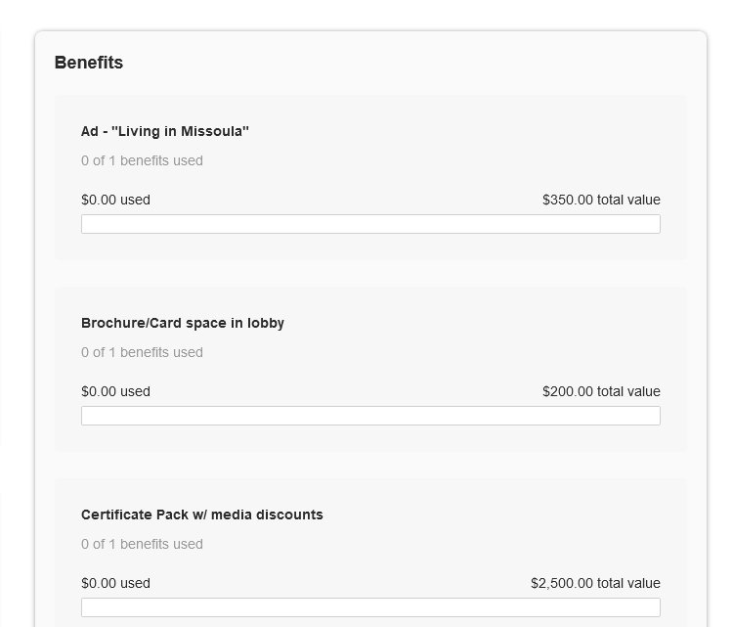
What can I do on my profile page?
Your business’s profile page will look like this.
Update your contact information (plus organization information if you’re the main contact or an editor)
Pay invoices for any related profiles (main contacts/editors) Access members only content
View your used and unused benefits and more
Upload media (company logo, directory photo gallery)
Change your password

Slide 4
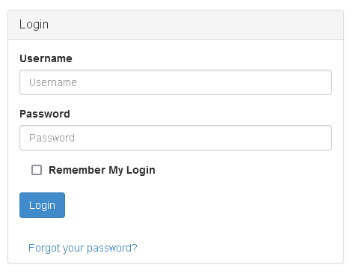
Log in to take control of your membership
You will need to use your username (Membership ID#) and password to gain access to our private Members Only Area. Please email info@missoulachamber if you need your authorization credentials
If you ever forget your password, click the ‘Forgot your password?’ link to receive an email with a password reset link

Slide 5
Switch Profiles
All business profiles have a MAIN contact. If not otherwise designated, the MAIN contact is also the BILLING contact and authorized EDITOR .
Each individual related to a business profile has their own individual profile.
Individuals can make changes to their profile but can not make changes to a business profile unless they are designated an EDITOR
If you are the MAIN contact or an EDITOR of your business profile, you will be able to easily switch the profile you are editing at any time! You can move from the business profile to individual profiles related to your business profile.
Make sure to SAVE any edits before you switch to another profile!

Slide 6
Menu Choices : Edit This Profile
This link will open a page that allows you to update much of the information on your profile. Individuals can change their profile information but must be an EDITOR to change business profile information.
Please contact the Chamber to be authorized as an Editor. It is usually assigned to the MAIN contact initially.
If you are an Editor for your related organization, you can click Switch Profile at any time to edit additional profiles. This helps us ensure we always have the latest information about you and your business.
You can edit the following information:
Name, address, and other basic contact information
Directory Listing category and descriptions and add keywords for search engines
Relationships you have to other profiles (including adding new profiles you are related to)
Social media accounts

Slide 7
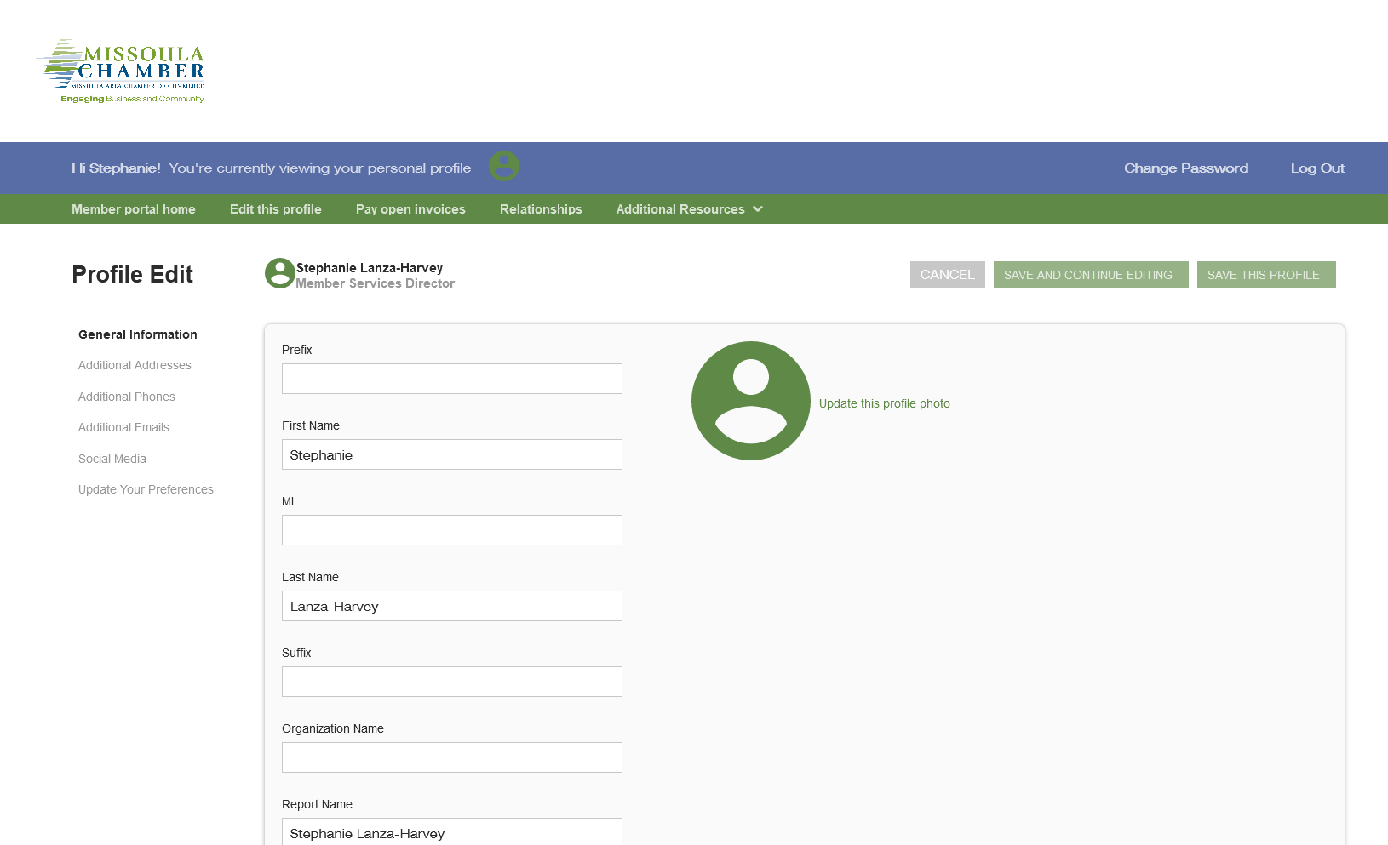
Edit This Profile
You have the ability to edit your profile. Staff marked as Main Contact or Editor are able to edit their related Organization(s) as well.
Once you make changes, they are submitted for approval by the Chamber.
If you have the right permissions, you can also edit the profiles related to your organization.

Slide 8
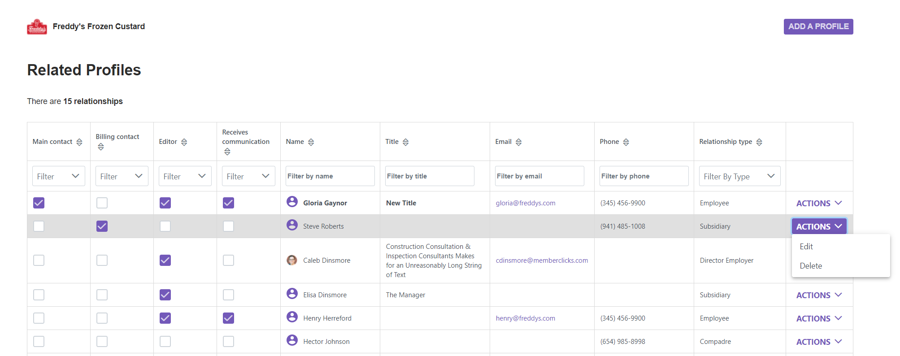
Relationships
Related Profiles are employees/contacts within your organization. You can designate Editors, Billing contacts and those that receive our newsletter. If we are communicating with your staff through email a contact record is attached to your profile but only if they are a contact related to your business.
The Relationships menu item (and Related Profiles area of the home page) shows all profiles related to the profile you’re editing
You can add new staff or relationships, as well as update existing relationships such as marking staff as former or marking new editors or main contacts for organizations
All updates you make are submitted for approval.
Make sure to Save.

Slide 9
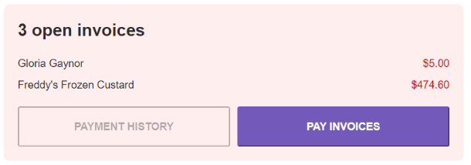
View Invoices and Renewal Information
From your Members Only profile page, Main Contacts and Editors can view all open invoices for their related profiles as well as renewal information
You can view Payment History and click to Pay Invoices

Slide 10
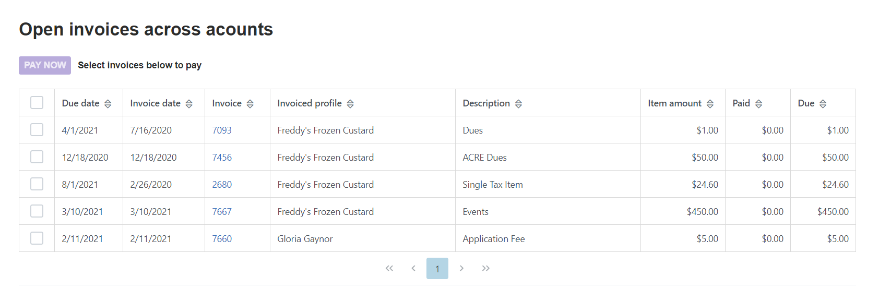
Pay Open Invoices
Menu Choices : Pay Open Invoices
Click Pay Open Invoices from top Navigation menu or the Pay Invoices button on the right side of the home page
Main Contacts and Editors will see company invoices, other staff will view only invoices connected to their individual profile
Select any invoices you would like to pay by checking the box in the first column
To print an invoice, click on the Invoice Number link.

Slide 11
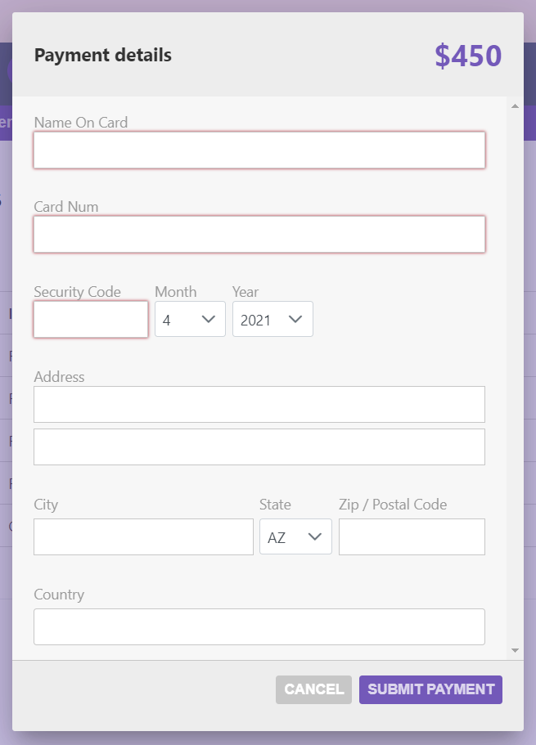
Paying Invoices
Once you select an invoice/invoices to pay, you will see a Payment details pop up screen, where you will enter your credit card and address payment information

Slide 12
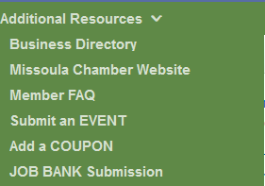
Additional Resources – Members Only Content
You can access members only content and resources under the Additional Resources link in the top navigation menu
There is a link that takes you directly to the Business Directory where you can look at your listing.
There is a link to the larger Missoula Chamber website
There is a link to the Member Faq page where you can get answers to many member questions and download documents to help with eblasts, banner ads etc.
You can submit an event to our Member Event Calendar
You can upload a Coupon from your business for other member business or the wider community
You can submit job openings to our Job Bank

Slide 13
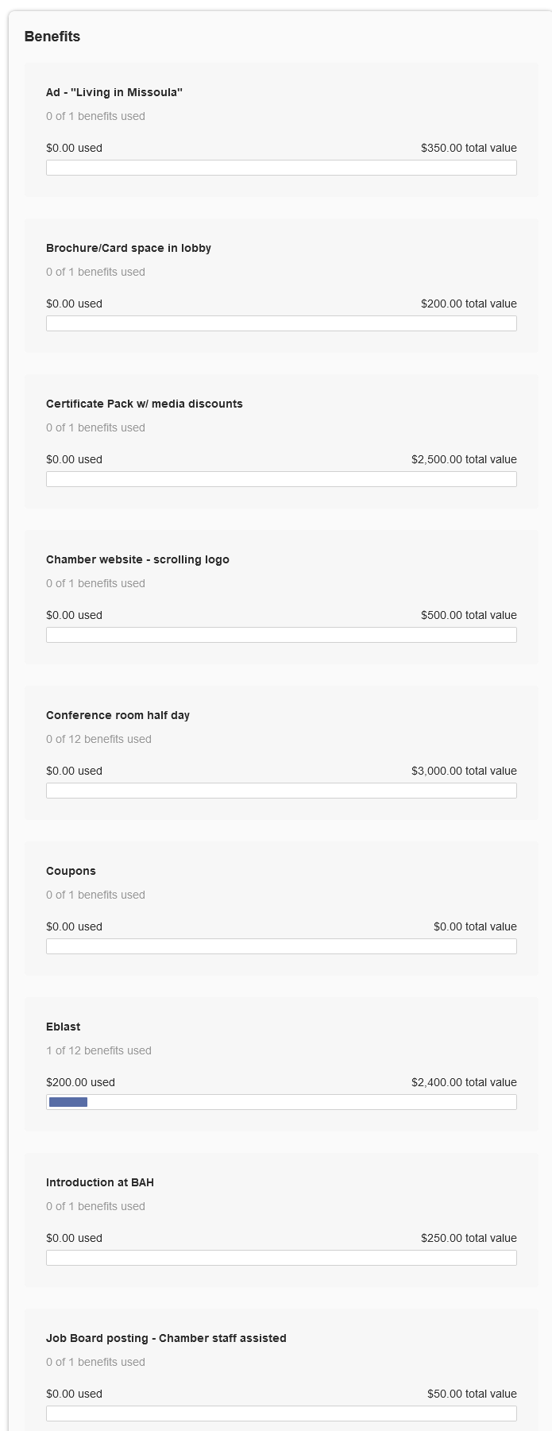
View Benefits
From the home page of your profile and any related profiles (for main contacts and editors), you can view event history, committee involvement, and member benefits – those you have and those you have used.
In the picture to the right you can see this profile has used one eblast so far this year.

Slide 14
Upload media
You have the ability to upload logos, pictures, and documents directly to your account, as well as images for your directory listing, if you have an enhanced membership level.
Our Online Member Directory can display images and videos on your listing, depending on your membership level. When accessed, this section of your members-only area will allow you to upload this media directly to your listing on the directory, so you can promote yourself as best as possible.
If you have the right member level, the images or video will display automatically on your directory listing; if you don't have the right level it will not appear (but it will be stored in your profile).
Click the ‘+ Add new’ button to add new content!

Slide 15
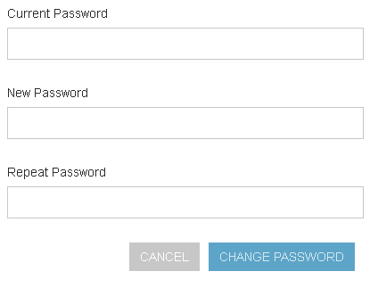
Change your password
The best parts of our website are restricted to only be used by members and their approved employees or related profiles. You can change your password at any time on the top right menu of the Members Only page.
Once you have a username and password, you can use it to access any members-only or restricted items.

Slide 16
Check out other areas of our website
To access any of the public resources on our site and check out your Directory listing, you can use the links at the top of the portal
Under Additional Resources you will find a link to the Business Directory and a direct link to our website, as well as the Member FAQ page.
Portal Header

Slide 17
Please contact the Missoula Chamber
at info@missoulachamber.com
if you have any questions about
your member portal.
We hope this PDF was helpful!

